Slide 1
CS 4662 Heart Failure Prediction Presentation
Team Members: Harish Lakshman, Steven Gonzales, Shalini Nistala
Date April 26th 2025

Slide 2
Introduction
Purpose:
"To create and compare different machine learning algorithms for generating predictive models aimed at predicting Heart Failure based on patient data."
Goals:
"Utilize the dataset containing patient characteristics diagnosed with cancer to train and test various models and algorithms. The ultimate goal is early and accurate cancer diagnosis through machine learning."

Slide 3
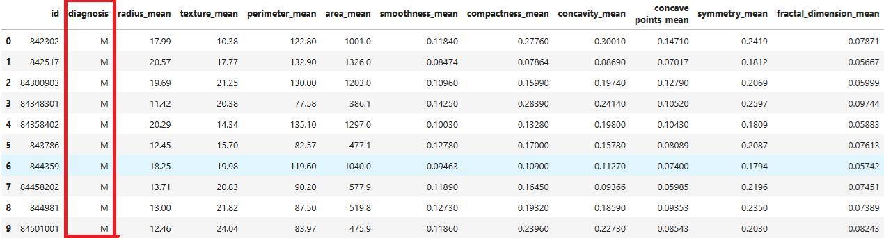
Methodology
Data Overview:
“Cancer dataset includes features such as radius mean, texture mean, etc., depicted in Figure 1."
Data Processing Steps:
"Datasets were loaded into data frames from sklearn."
"Features and labels were analyzed through histograms and box plots to understand distributions and outliers (Figures 1 and 2)."
"Statistical summaries provided insights into feature behaviors (Figure 2)."
"Categorical data within the features was identified and transformed for model training."
Figures 1

Slide 4
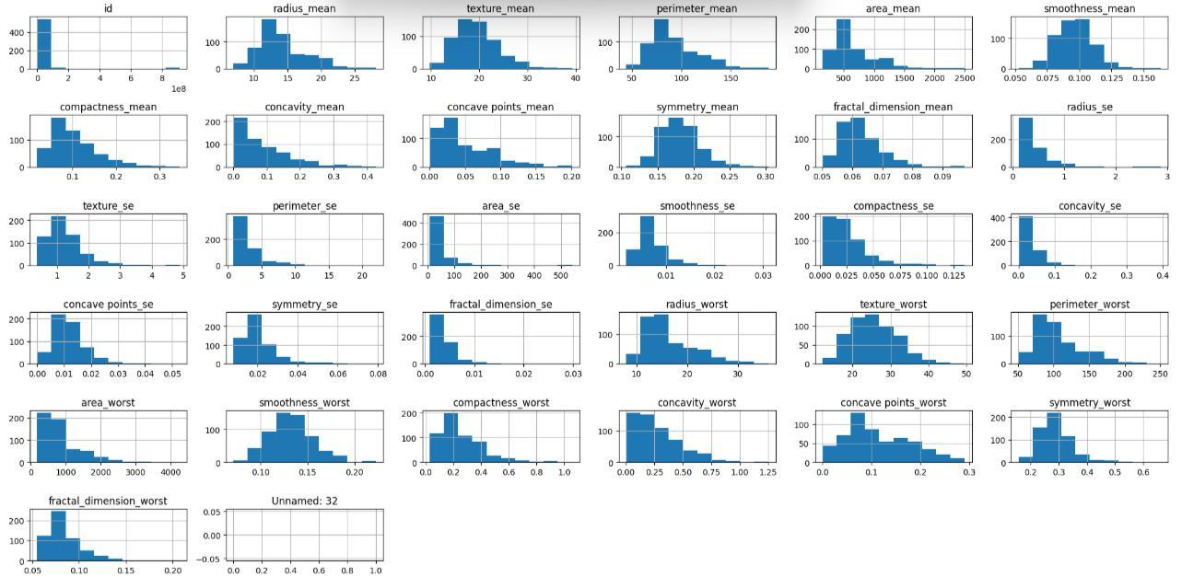
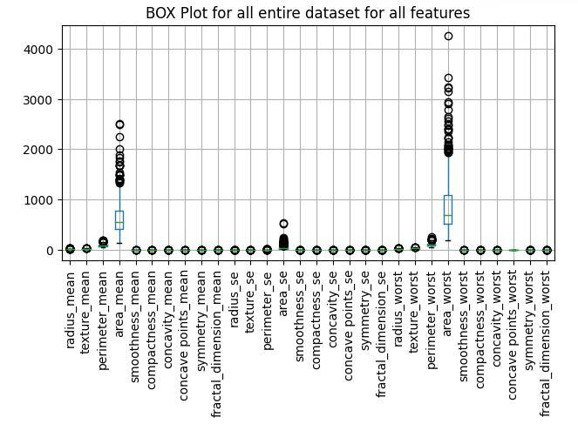
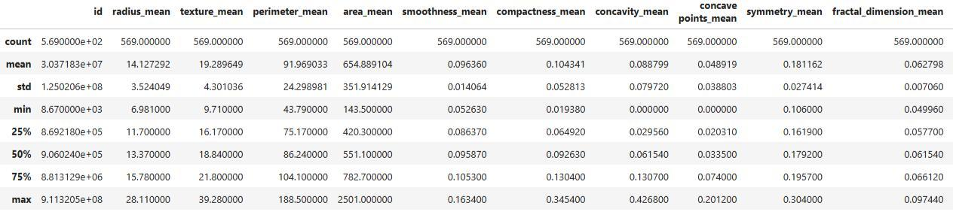
Figures 1: Histograms show distribution of numerical data for features
Figures 3: Box plot shows a graphical representation of the mean, median, standard deviation & outliers for all features
Figures 2: statistical summary tabulates the box plot results in an easy-to-read description
Data Analysis & Feature Extraction

Slide 5
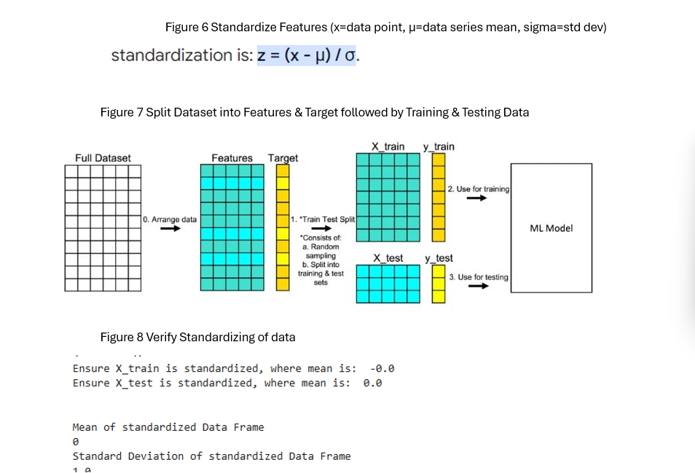
Extract Features & Labels. Standardize Features. Encode Labels & Split data

Slide 6
Machine Learning Algorithms used
Random Forest Classification
The target Label for Cancer Data set is a categorical outcome, Diagnosis (Malignant or Binary).
Hence the classification approach was chosen.
Random Forest Logistic Regression
The Binary Label or Diagnosis is Encoded & the Regression model is trained to generate predictions between 0 & 1.
A sigmoid or discretize function is used to map predicted values to probabilities between 0 & 1.
The output probability is then thresholded (0.4) to classify results into categories.

Slide 7
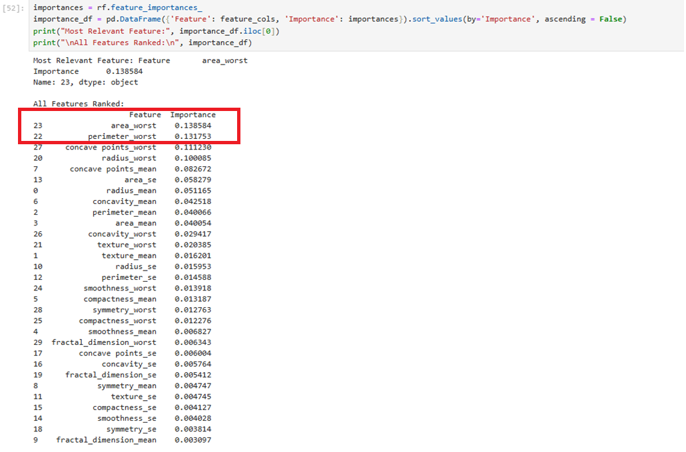
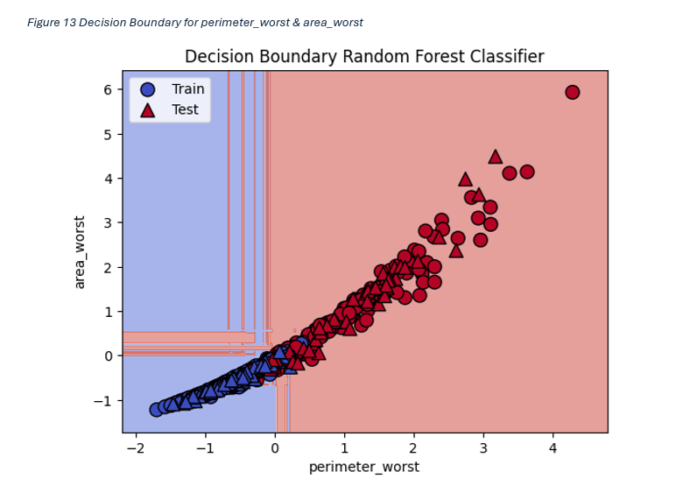
Analysis of Most Important Features
“area_worst “ & “perimter_worst” features contribute highest to the disease diagnosis

Slide 8
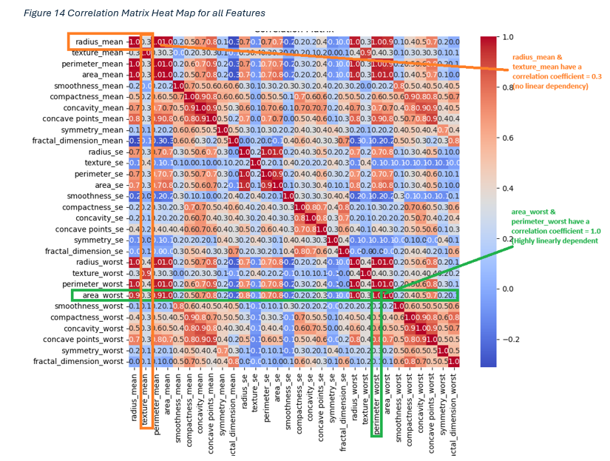
“area_worst” & “perimeter_worst” contribute highest to Cancer diagnosis but are also highly correlated to each other.

Slide 9
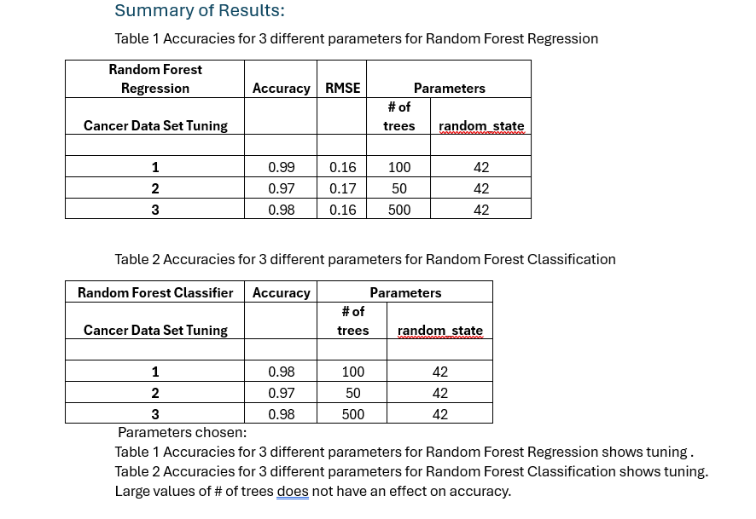
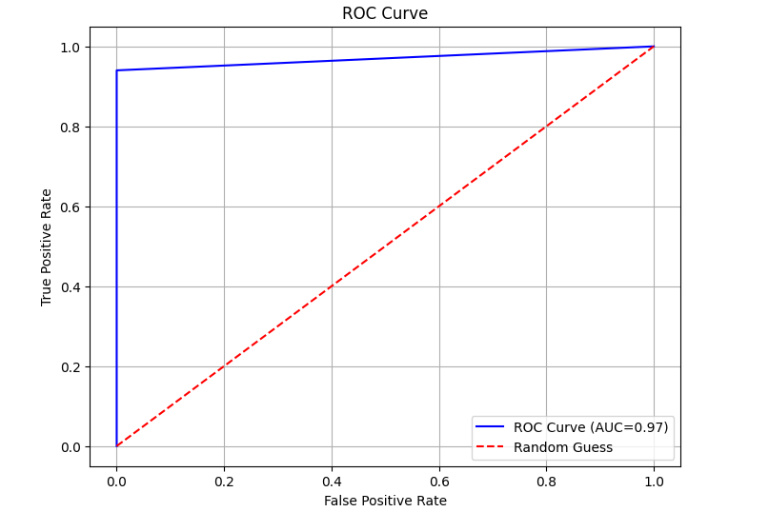
Results: ML Algorithms for Random Forest Classification & Random Forest Logistic Regression were executed
AUC of 0.97 indicated excellent discrimination

Slide 10
Project Roadmap
September 10
October 16/20
November 9/15
December 1/5
Meeting 1
Meeting 2/3
Meeting 4/5
Meeting 5/6
Met with the TA to deliver our project proposal.
Came together to discuss how to divide up the work as well as finalize a clear direction for the project
Quick meetings designed for a quick progress report.
Finalized the code as well as the project report

Slide 11
Code
Our code

